Slide 1
Operating Systems Design -19CS2106S Skill Session- 09
Understanding vm.c
Ps
backtrace

Slide 2
Vm.c (allocuvm)
int
allocuvm(pde_t *pgdir, uint oldsz, uint newsz)
{
char *mem;
uint a;
if(newsz >= KERNBASE)
return 0;
if(newsz < oldsz)
return oldsz;
a = PGROUNDUP(oldsz);
for(; a < newsz; a += PGSIZE){
mem = kalloc();
if(mem == 0){
cprintf("allocuvm out of memory\n");
deallocuvm(pgdir, newsz, oldsz);
return 0;
}
memset(mem, 0, PGSIZE);
if(mappages(pgdir, (char*)a, PGSIZE, V2P(mem), PTE_W|PTE_U) < 0){
cprintf("allocuvm out of memory (2)\n");
deallocuvm(pgdir, newsz, oldsz);
kfree(mem);
return 0;
}
}
return newsz;
}

Slide 3
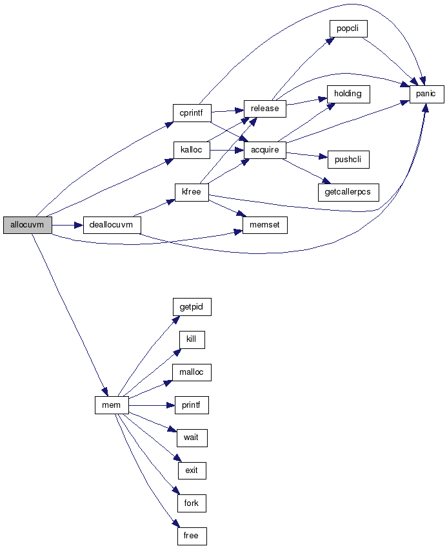

Slide 4
Vm.c(Deallocuvm)
int
deallocuvm(pde_t *pgdir, uint oldsz, uint newsz)
{
pte_t *pte;
uint a, pa;
if(newsz >= oldsz)
return oldsz;
a = PGROUNDUP(newsz);
for(; a < oldsz; a += PGSIZE){
pte = walkpgdir(pgdir, (char*)a, 0);
if(!pte)
a = PGADDR(PDX(a) + 1, 0, 0) - PGSIZE;
else if((*pte & PTE_P) != 0){
pa = PTE_ADDR(*pte);
if(pa == 0)
panic("kfree");
char *v = P2V(pa);
kfree(v);
*pte = 0;
}
}
return newsz;
}

Slide 5
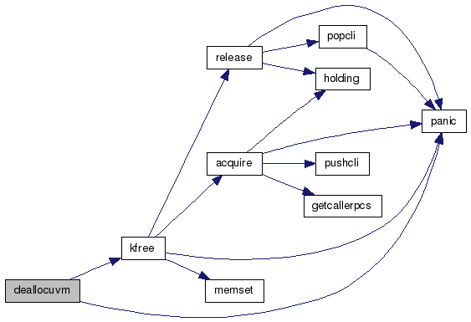

Slide 6
Vm.c (seginit)
void seginit(void)
{
struct cpu *c;
// Map "logical" addresses to virtual addresses using identity map.
// Cannot share a CODE descriptor for both kernel and user
// because it would have to have DPL_USR, but the CPU forbids
// an interrupt from CPL=0 to DPL=3.
c = &cpus[cpunum()];
c->gdt[SEG_KCODE] = SEG(STA_X|STA_R, 0, 0xffffffff, 0);
c->gdt[SEG_KDATA] = SEG(STA_W, 0, 0xffffffff, 0);
c->gdt[SEG_UCODE] = SEG(STA_X|STA_R, 0, 0xffffffff, DPL_USER);
c->gdt[SEG_UDATA] = SEG(STA_W, 0, 0xffffffff, DPL_USER);
// Map cpu, and curproc
c->gdt[SEG_KCPU] = SEG(STA_W, &c->cpu, 8, 0);
lgdt(c->gdt, sizeof(c->gdt));
loadgs(SEG_KCPU << 3);
// Initialize cpu-local storage.
cpu = c;
proc = 0;
}

Slide 7
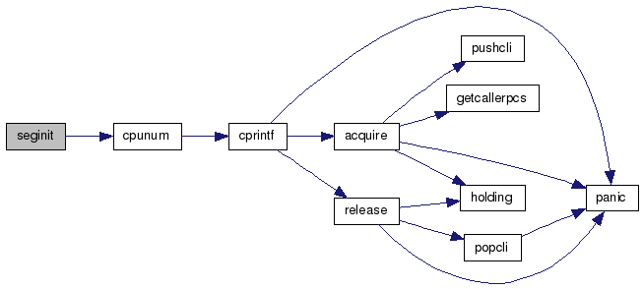

Slide 8
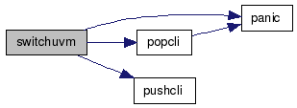
Vm.c(Switchuvm)
void switchuvm(struct proc * p)
{
pushcli();
cpu->gdt[SEG_TSS] = SEG16(STS_T32A, &cpu->ts, sizeof(cpu->ts)-1, 0);
cpu->gdt[SEG_TSS].s = 0;
cpu->ts.ss0 = SEG_KDATA << 3;
cpu->ts.esp0 = (uint)proc->kstack + KSTACKSIZE;
ltr(SEG_TSS << 3);
if(p->pgdir == 0)
panic("switchuvm: no pgdir");
lcr3(v2p(p->pgdir)); // switch to new address space
popcli();
}

Slide 9
“PS” SystemCall
Ps is used to find Process Status
ps command is used to list the currently running processes and their PIDs along with some other information depends on different options.
It reads the process information from the virtual files in /proc file-system.
/proc contains virtual files, this is the reason it’s referred as a virtual file system.

Slide 10
Adding PS System Call to XV6
Step 1: Ps.c (nano ps.c)
#include "types.h"
#include "stat.h"
#include "user.h"
#include "uproc.h"
#define STDOUT 1
#define NPROC 3 // maximum number of processes
void getprocdata()
{
int i = 0;
struct uproc up;
printf(STDOUT, "Name\tpid\tppid\tsize\t\twaiting_on_channel\tkilled\n");
printf(STDOUT, "-----------------------------------------------------------------------------\n");
for (i=0; i<NPROC; i++) {
getprocinfo(i, &up);
printf(STDOUT, "%s\t%d\t%d\t%d\t\t%d\t\t%d\n", up.name, up.pid, up.ppid, up.sz, up.wait, up.killed);
}
exit();
}
int
main(int argc, char *argv[])
{
getprocdata();
exit();
}

Slide 11
Step 2: Syscall.c (nano syscall.c)
extern int sys_getprocinfo(void);
[SYS_getprocinfo] sys_getprocinfo,
Step 3: Syscall.h (nano syscall.h)
#define SYS_getprocinfo 22
Step 4: Sysproc.c (nano sysproc.c)
int
sys_getprocinfo()
{
int proc_num, size = sizeof(struct uproc);
struct uproc *up;
if ((argint(0, &proc_num) < 0) || (argptr(1, (char **)&up, size) < 0))
return -1;
return getprocinfo(proc_num, up);
}

Slide 12
Step 5: User.h (nano user.h)
struct stat;
struct rtcdate;
struct uproc;
//Add this in System Calls block
int getprocinfo(int, struct uproc*);
Step 6: usys.S (nano usys.S)
SYSCALL(getprocinfo)
Step 7: Proc.h (nano proc.h)
//Add at the end
struct uproc{
char name[16];
int pid;
int ppid;
uint sz;
int state;
int wait;
int killed;
};

Slide 13
Step 8: Proc.c (nano proc.c)
// Add below code in proc.c at the end
int getprocinfo(int proc_num, struct uproc *up) {
struct proc *p;
if (proc_num >= NPROC)
return -1;
p = &ptable.proc[proc_num];
memset(up, 0, sizeof(struct uproc));
memmove(up->name, p->name, 16);
up->pid = p->pid;
up->state = p->state;
if ((up->state != UNUSED)) {
up->ppid = p->parent->pid;
up->sz = p->sz;
}
if (up->pid == 1) {
up->sz = p->sz;
up->ppid = 0;
}
if (p->chan)
up->wait = 1;
else
up->wait = 0;
up->killed = p->killed;
return 0;
}

Slide 14
Step 9: defs.h (nano defs.h)
//Add struct uproc here..
struct buf;
struct context;
struct file;
struct inode;
struct pipe;
struct proc;
struct uproc;
//pagebreak 16 //proc.c (In defs.h)
int getprocinfo(int, struct uproc*);

Slide 15
Step 10: uproc.h (nano uproc.h)
#include "types.h"
struct uproc{
char name[16];
int pid;
int ppid;
uint sz;
int state;
int wait;
int killed;
};
Step 11: Makefile (nano Makefile)
$ nano Makefile
//In UPROGS\ section, Add
_ps\
//In Extras Section, Add
ps.c

Slide 16
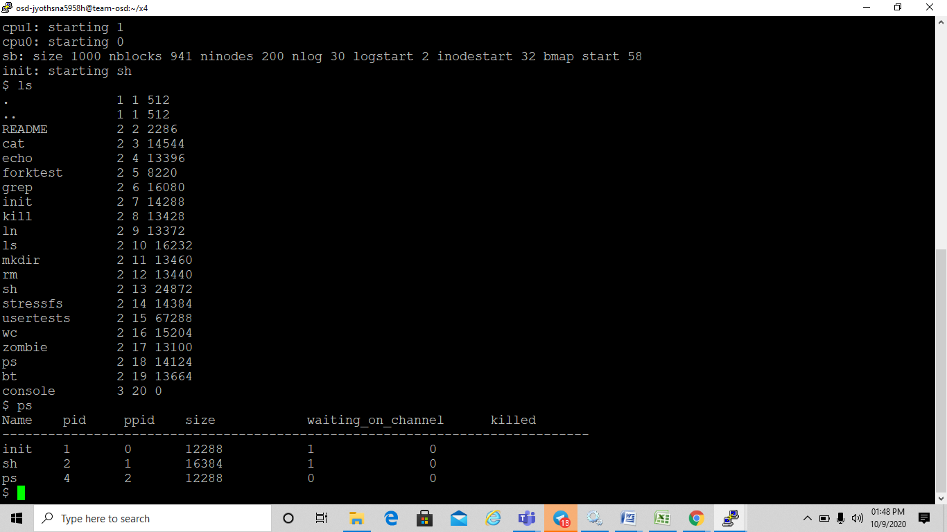
Output

Slide 17
“BackTrace” SystemCall
A Backtrace is a list of the function calls that are currently active in a thread.
The backtrace_symbols function translates the information obtained from the backtrace function into an array of strings.
The argument buffer should be a pointer to an array of addresses obtained via the backtrace function, and size is the number of entries in that array (the return value of backtrace).

Slide 18
Adding BackTrace System Call to XV6
Step-1: Syscall.h
$ nano syscall.h
#define SYS_backtrace 23
Step 2: Syscall.c
$ nano syscall.c
extern int sys_backtrace(void);
[SYS_backtrace] sys_backtrace,

Slide 19
Step 3: Sysproc.c
$ nano sysproc.c
int
sys_backtrace(void)
{
//struct proc *curproc = myproc();
uint ebp, ret_addr, next_addr;
int count = 0;
struct trapframe *tf = myproc()->tf;
cprintf("eax : 0x%x\n", tf->eax);
cprintf("ebx : 0x%x\n", tf->ebx);
cprintf("ecx : 0x%x\n", tf->ecx);
cprintf("edx : 0x%x\n", tf->edx);
cprintf("edi : 0x%x\n", tf->edi);
cprintf("esi : 0x%x\n", tf->esi);
cprintf("esp : 0x%x\n", tf->esp);
cprintf("ebp : 0x%x\n", tf->ebp);
cprintf("eip : 0x%x\n", tf->eip);
ebp = tf->ebp;
next_addr = tf->eip;
while(next_addr && next_addr != (uint)-1) {
ret_addr = *(uint *) (ebp + 4);
cprintf("#%d 0x%x\n", count++, ret_addr);
ebp = *(uint *)ebp;
next_addr = ret_addr;
}
return 0;
}

Slide 20
Step 4: Usys.S
$ nano usys.s
SYSCALL(backtrace)
Step 5: User.h
$ nano user.h
int backtrace(void);
Step 6: defs.h
$ nano defs.h
int backtrace(void);

Slide 21
Step 7: bt.c
$ nano bt.c
#include "types.h"
#include "stat.h"
#include "user.h"
int baz() __attribute__((noinline));
int baz() {
int a;
a = backtrace();
return a + uptime();
}
int bar() __attribute__((noinline));
int bar() {
int b;
b = baz();
return b + uptime();
}
int foo() __attribute__((noinline));
int foo() {
int c;
c = bar();
return c + uptime();
}
int
main(int argc, char *argv[])
{
foo();
exit();
}

Slide 22
Step 8: Makefile
$ nano Makefile
//In UPROGS, add
_bt\
//In EXTRAS, add
bt.c
Step 9: make clean
Step 10: make
Step 11: make qemu-nox

Slide 23
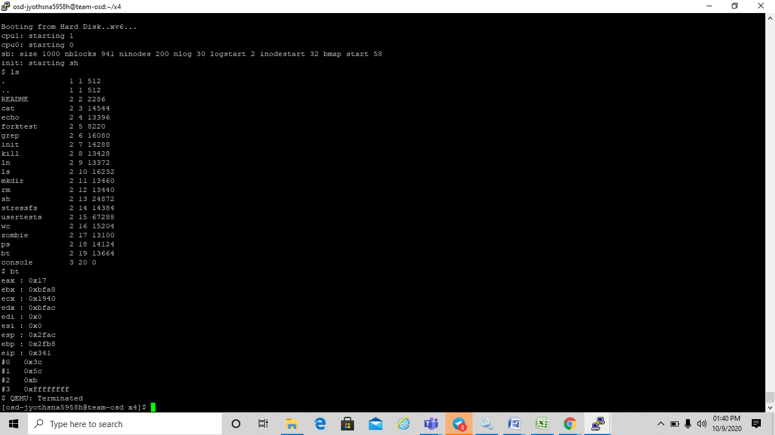
Output

